Slide 1
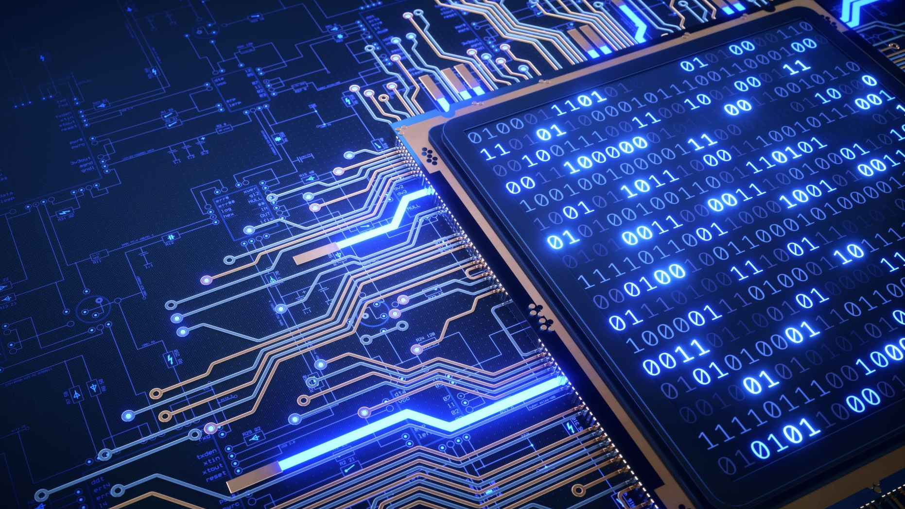
WEARABLE TECHNOLOGY
K.M.SRINIVAS
-20P71A6238

Slide 2
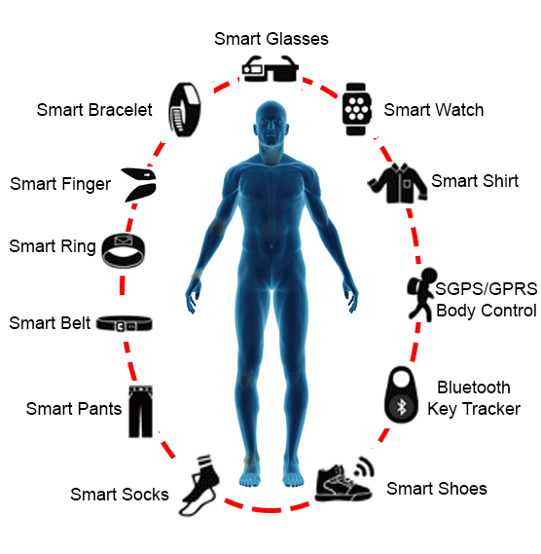
WHAT IS WEARABLE TECHNOLOGY ?
Wearable technology also known as “wearables”, is a category of electronic devices that can be worn as accessories, embedded in clothing, implanted in the user’s body, or even tattooed on the skin. The devices are hands-free gadgets with practical uses, powered by microprocessors and enhanced with ability to send and receive data via the internet.
Wearable technology is evolving into an important category of the internet of things, with life-changing application in medicine and other fields.

Slide 3
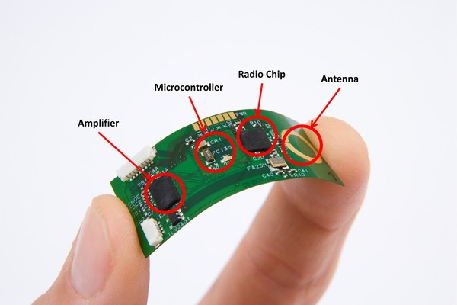
HOW WEARABLE TECHNOLOGY WORKS
The growth of mobile networks enabled the development of wearable technology. It is technology which has devices attached to the clothes we wear.
Sensors can also be attached around a wearable device to allow them to monitor various activities in the area. Most sensors can track motion, brain activity, heart activity, and muscle activity. We can mostly see them in health-oriented devices.
Miniature computers are also inside some wearable devices, similar to how smartphones have miniature processors inside of them. These are found in smart-watches and other wearables that are supposed to help us interact with other objects in the vicinity.

Slide 4
WHAT DATA DOES WEARABLE TECHNOLOGY COLLECT
Wearables serve two main purposes:
To track a specific condition.
And to help users maintain good health.
Wearables can collect a host of data to execute these roles. Some of the collected data include step taken, food and water intake, calories burned, sleep movement and breathing.
Wearable technology can also collect biometric data such as heart rate(ECG & HRV) and muscle bio-signals(EMG) from the human body to provide valuable information in the field of health care and wellness.
Another increasingly popular wearable technology involves virtual reality.

Slide 5
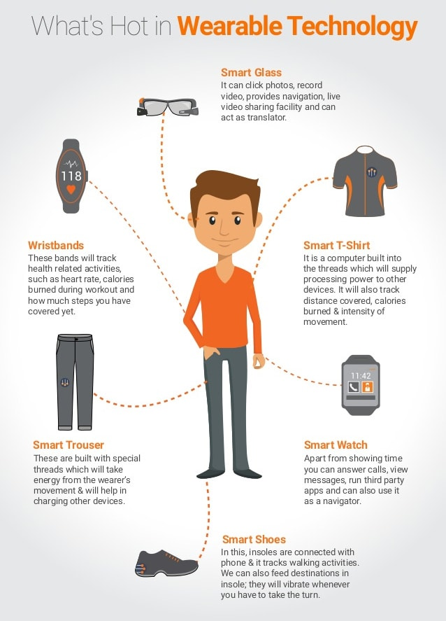

Slide 6

TECHNOLOGIES USED IN WEARABLE TECHNOLOGY
Internet of Things(IoT)
Big data
Artificial intelligence(AI)
Near field communication(NFC)
WearOS(by google) for android and IOS

Slide 7
SOURCE CODE USED IN WEARABLES
#include <iostream>
class WearableDevice {
public:
WearableDevice() {
// Initialization code
}
void displayMessage() {
std::cout << "Hello from the wearable device!" << std::endl;
}

Slide 8
// Add more functionality as needed
};
int main() {
WearableDevice myDevice;
myDevice.displayMessage();
// Additional logic for the wearable device application
return 0;
}

Slide 9
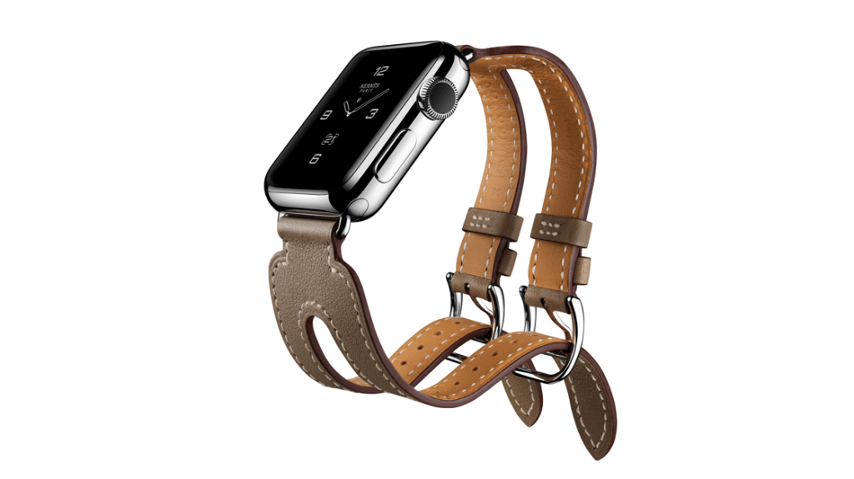
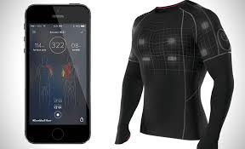
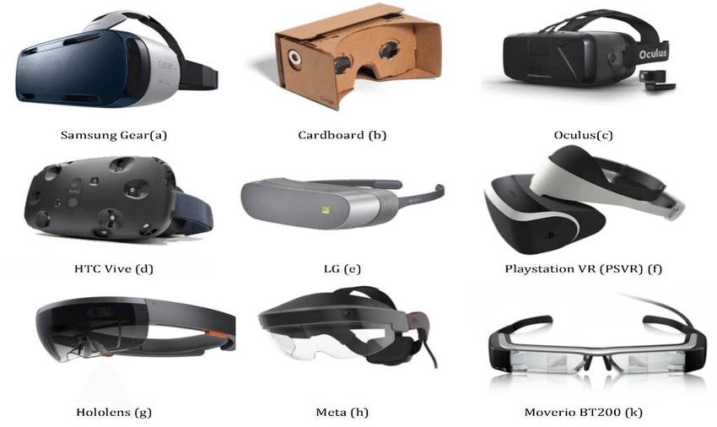
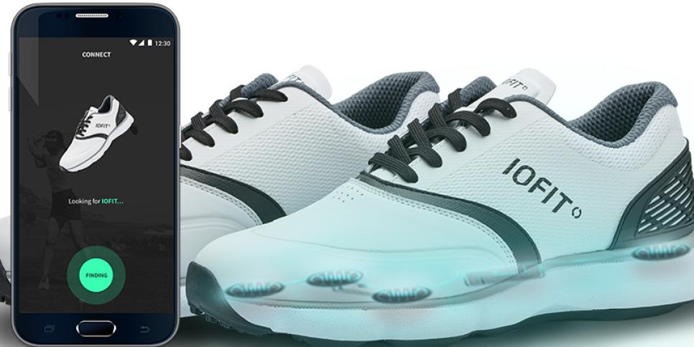
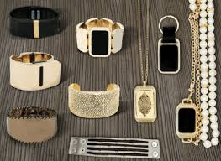
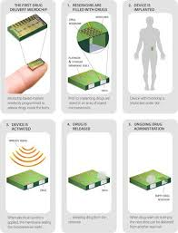
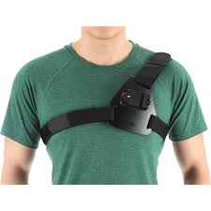
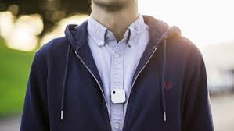
TYPES OF WEARABLE TECHNOLOGY
Smart watches
Smart glasses
Smart clothing
Fitness trackers
Body sensors
Wearable cameras
Head-mounted displays
Bluetooth headsets
Chest straps
Smart jewelry
Implantable wearable
Gesture control wearable
Exoskeletons
Location trackers

Slide 10
PROS
Wearable technology provides us with the ability to monitor our fitness levels, track our location with GPS, and view text messages more quickly. Best of all, most of the devices that allow us to do this are hands free and portable, eliminating the need to take our devices out of our pockets.
Before wearables, it was possible to obtain a lot of the information listed above, but it was sometimes a hassle and required devices that weren't always convenient. Wearables are connected to our smart devices, transmitting this information to them and allowing us to view it at later times, as well as in the moment. This can help you with setting goals and tracking your progress toward them.

Slide 11
CONS
Wearables tend to have a fairly short battery life. Some devices, like the simpler Fitbit trackers, can last for several days. But some of the more advanced wearables, like the Apple Watch, will only last for a day or so. For some, it can be a hassle to remember to regularly remove your wearable to charge it. Because of this, a number of developers are looking into the possibility of wireless charging options that would eliminate the need to remove the device.
Some wearables have been reported to measure data inaccurately on occasion. This can be especially dangerous when measuring data like heart rates. For individuals with heart conditions, this false reading could lead to overexertion and further health issues.
Ultimately, it's up to you to decide whether a wearable device is something from which you would benefit. With their increase in popularity, it's important to weigh the pros and cons before committing to one.

Slide 12
THE FUTURE OF WEARABLE TECHNOLOGY
Smartwatches, fitness trackers, and VR/AR headsets have become more and more prevalent in our society over the past several years. It's predicted that wearables will only continue to grow in popularity, so naturally companies are finding new and innovative ways to apply them to our everyday lives. Below are just a few of the directions wearable production may be headed.
Lower visibility
Longer battery life
Medical wearables
Authentication

Slide 13
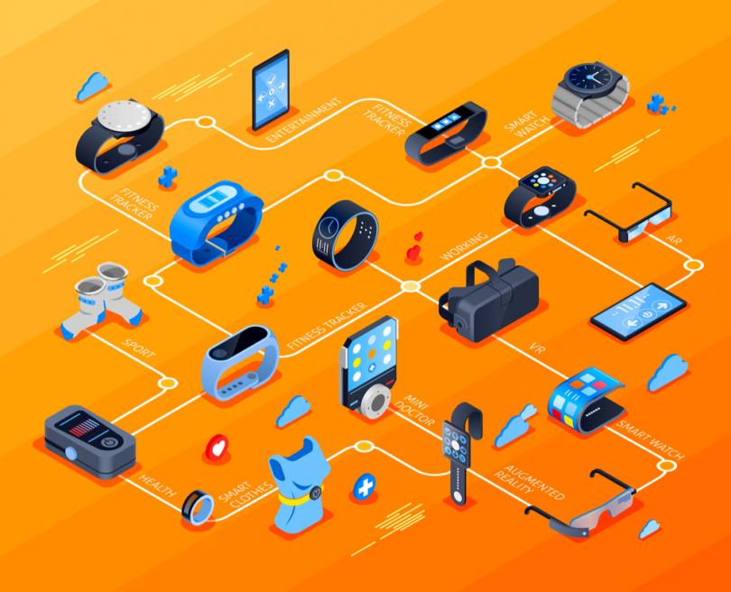
THANK YOU

